Slide 1
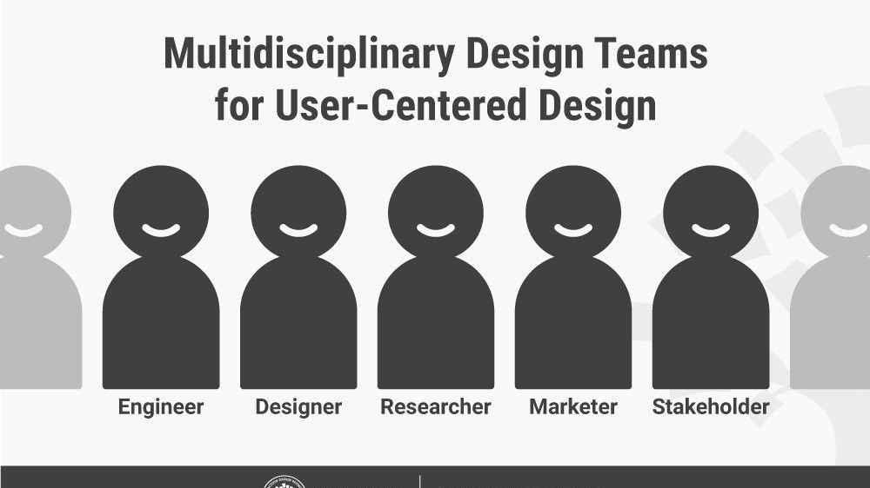

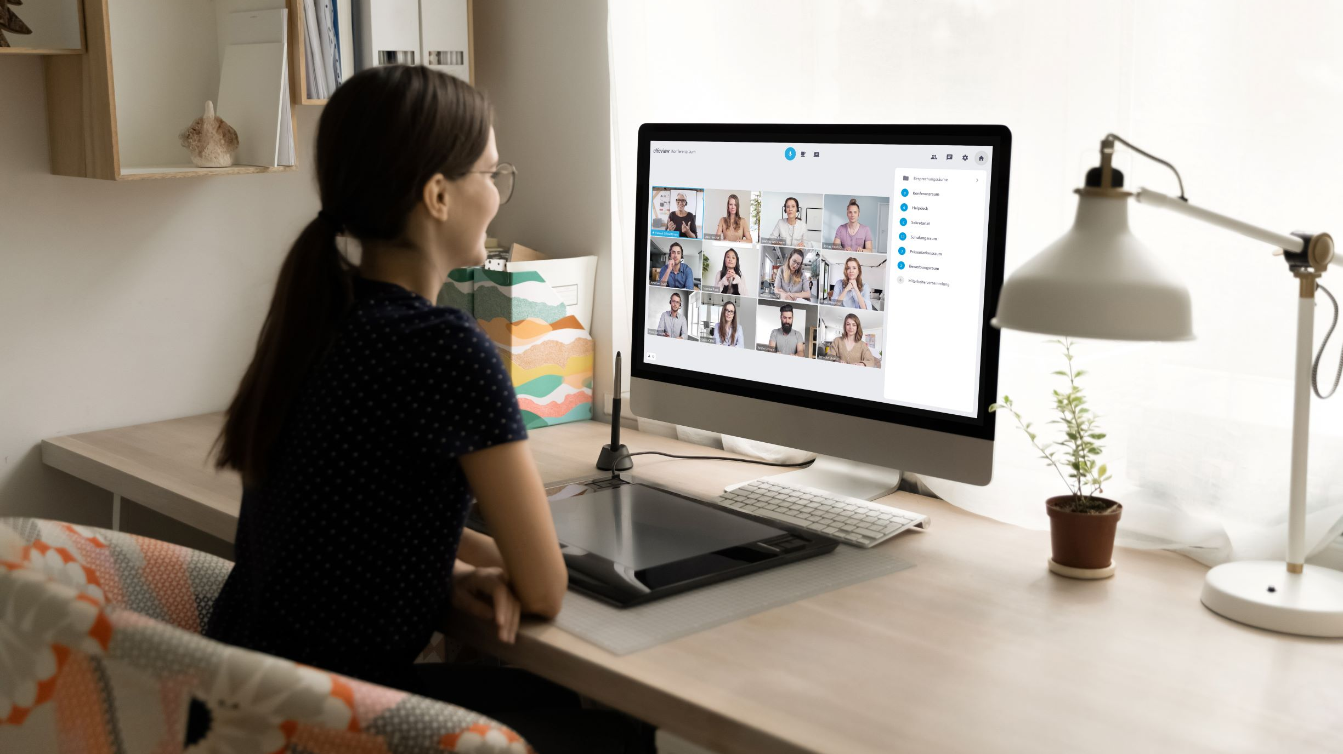

Team? Work & Travel? Work From Home?

Slide 2
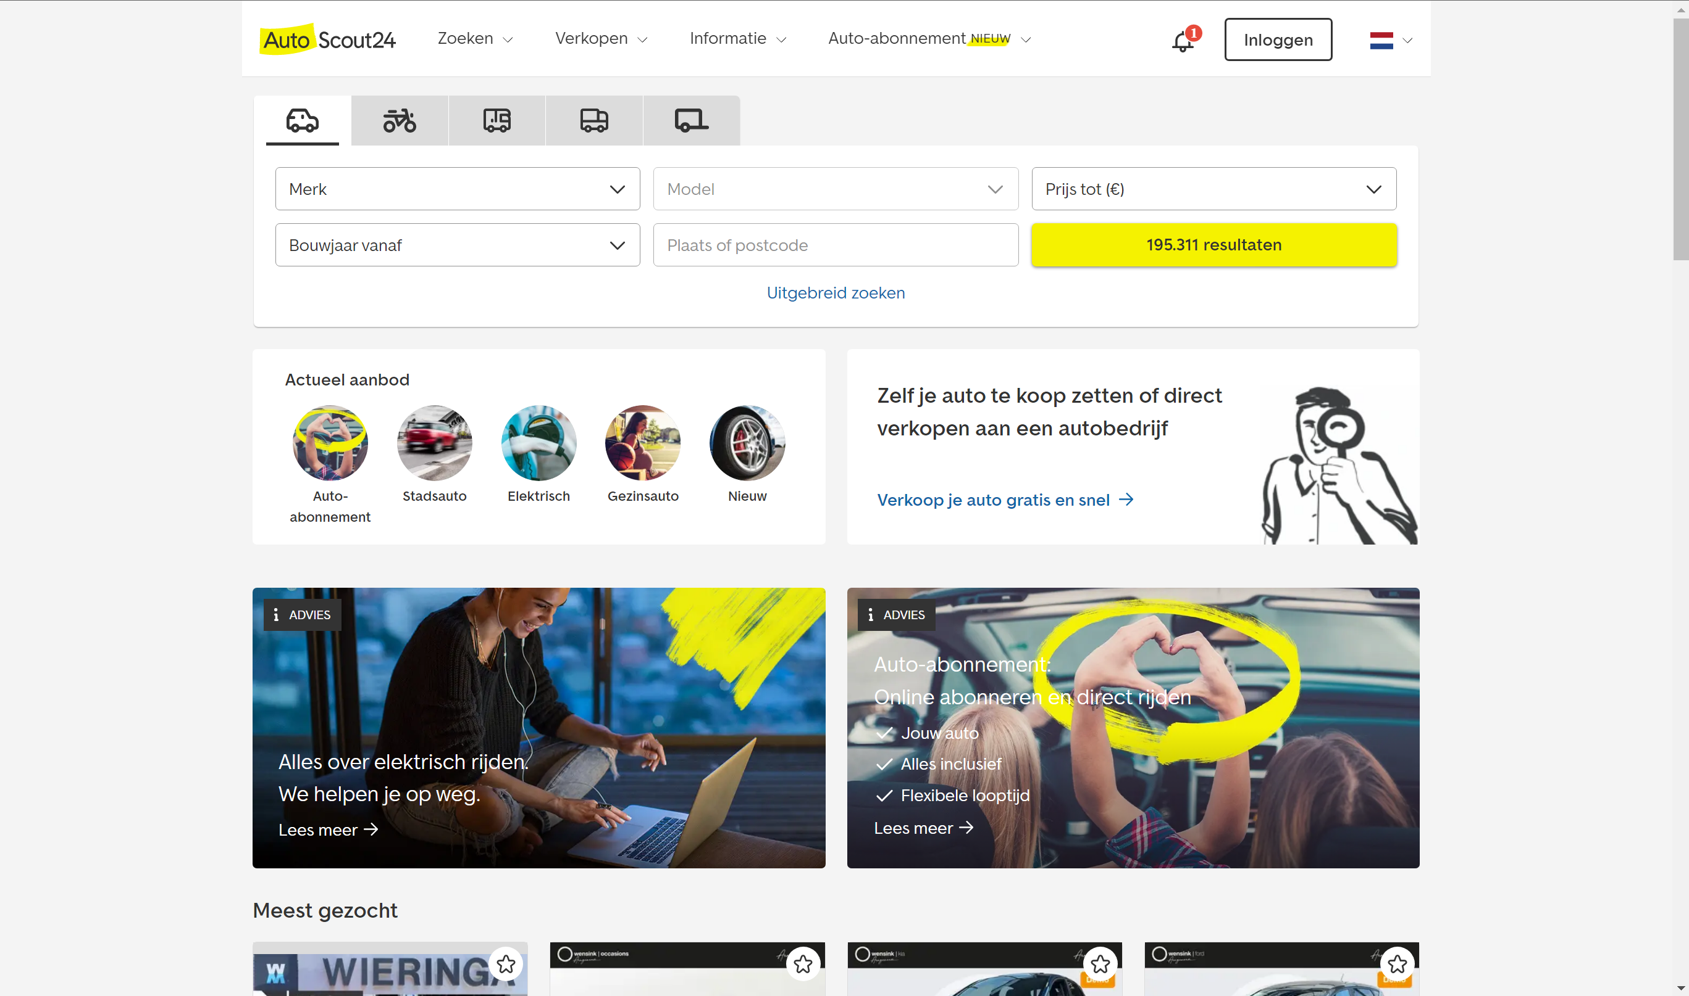
Good UCD – AutoScout24
Website is used to find cars
Therefore, they have put the search options at the top of the screen
They also use yellow highlights which stand for happiness

Slide 3
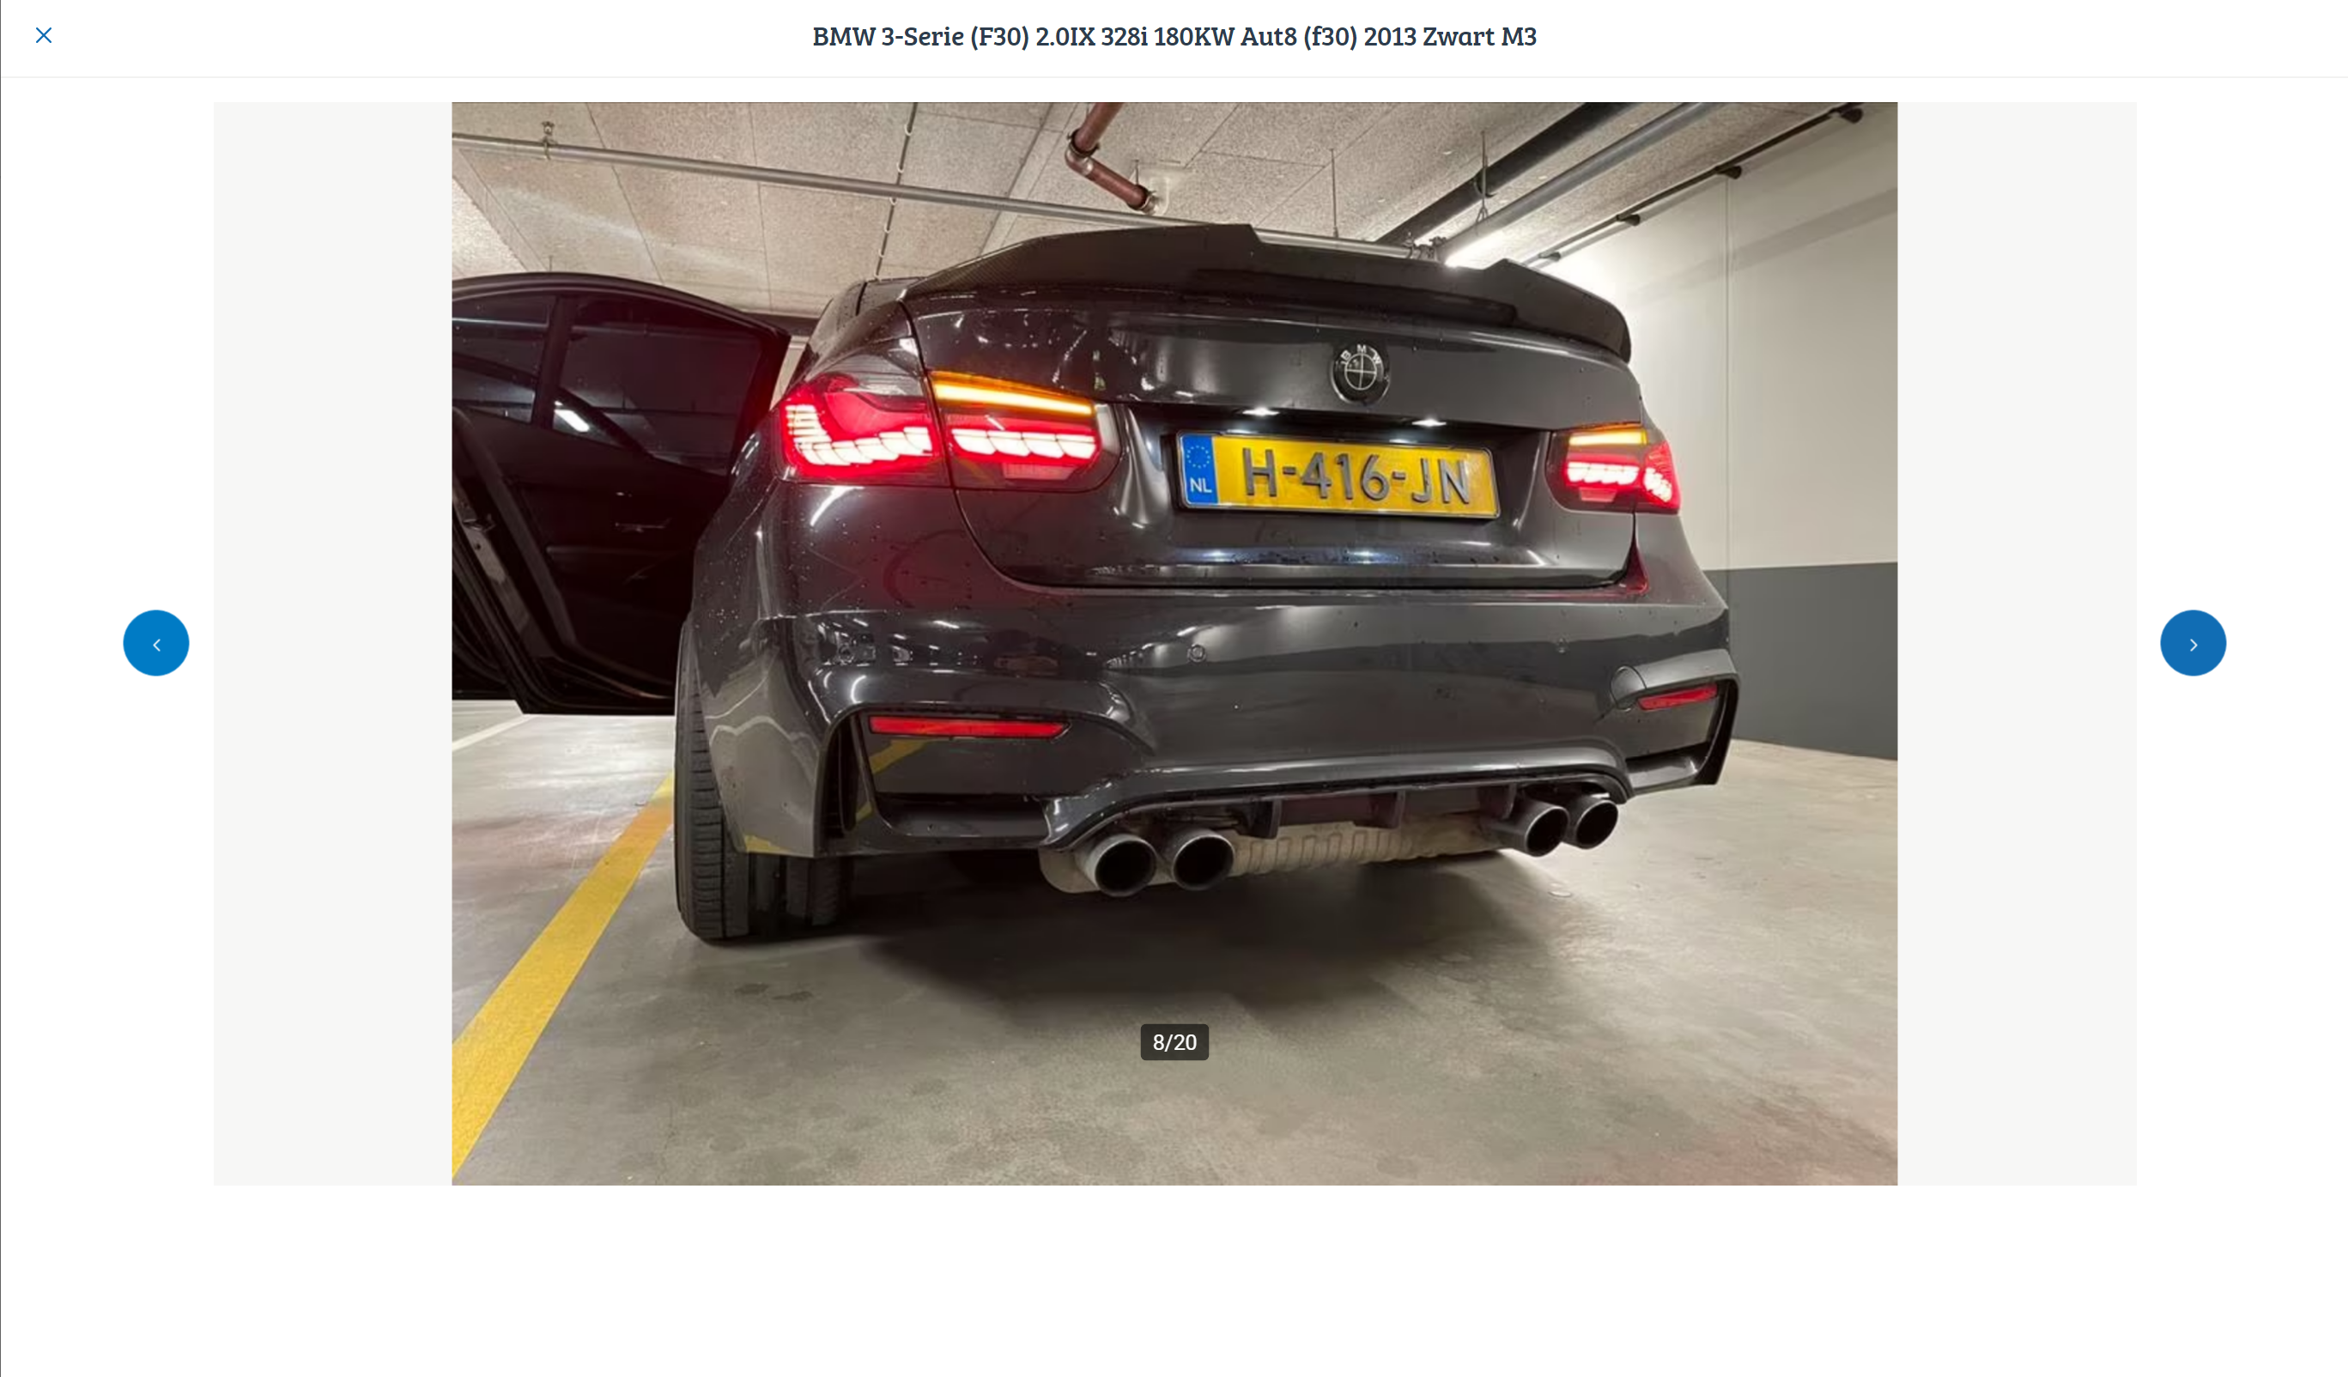
Bad UCD - Marktplaats
The exit button for the fullscreen photo mode is all the way on the left top and pretty small. Most websites will minimize the picture by clicking next to it. Therefore, I’m pretty used to clicking on the right side and now I have to go all the way to the left.

Slide 4
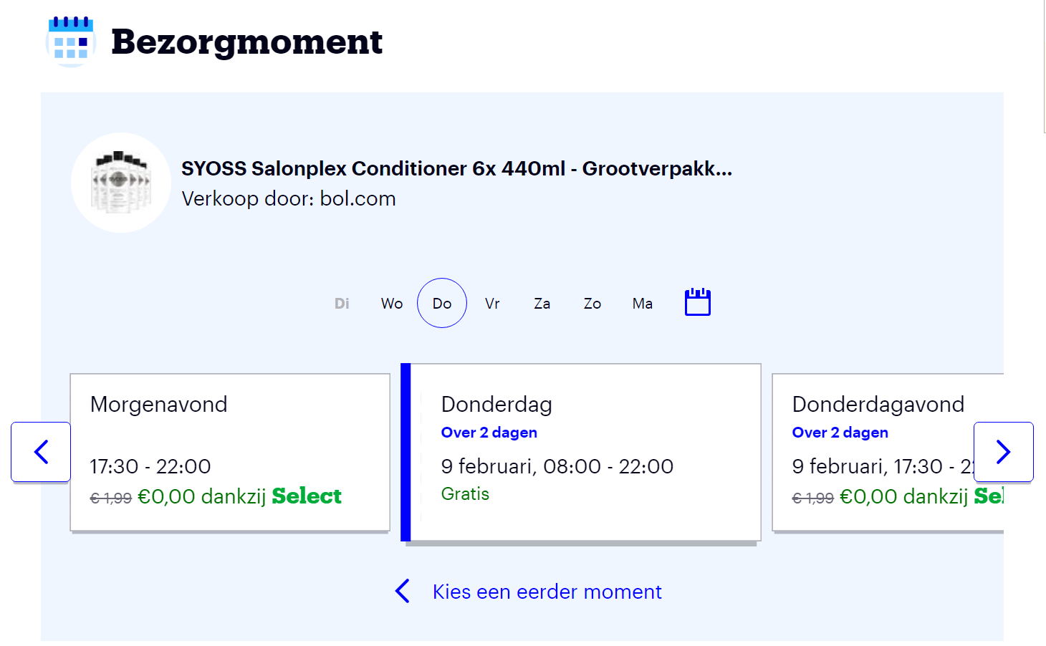
Good UCD – Bol.com
The display of the available delivery days and times are very clear. Especially because you can select the day and it’ll pop to the front from the other days. Additionally, the day’s shortcuts are written above the boxes to click on and skip to that day.

Slide 5
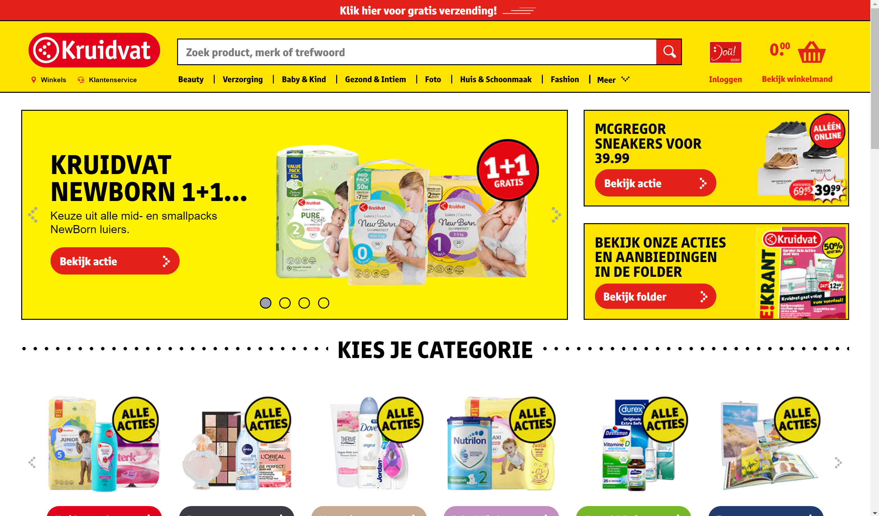
Bad UCD - Kruidvat
Very cluttered and conflicting colors
Yellow = happiness
Red = danger
Many boxes and a lot of text or repeating images

Slide 6
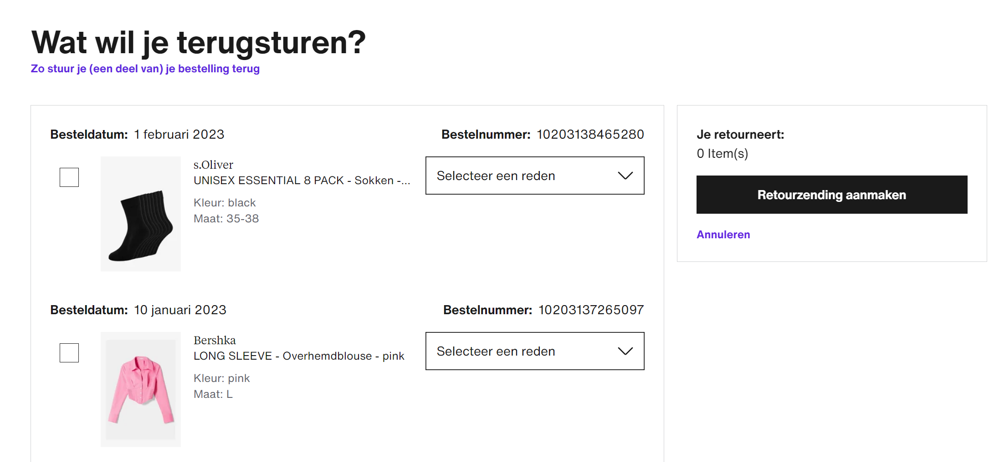
Good UCD - Zalando
Easy to manage return page.
Pictures to make clear which order it is instead of just the numbers.
Check which order, select a reason for returning, and confirm the return.

Slide 7
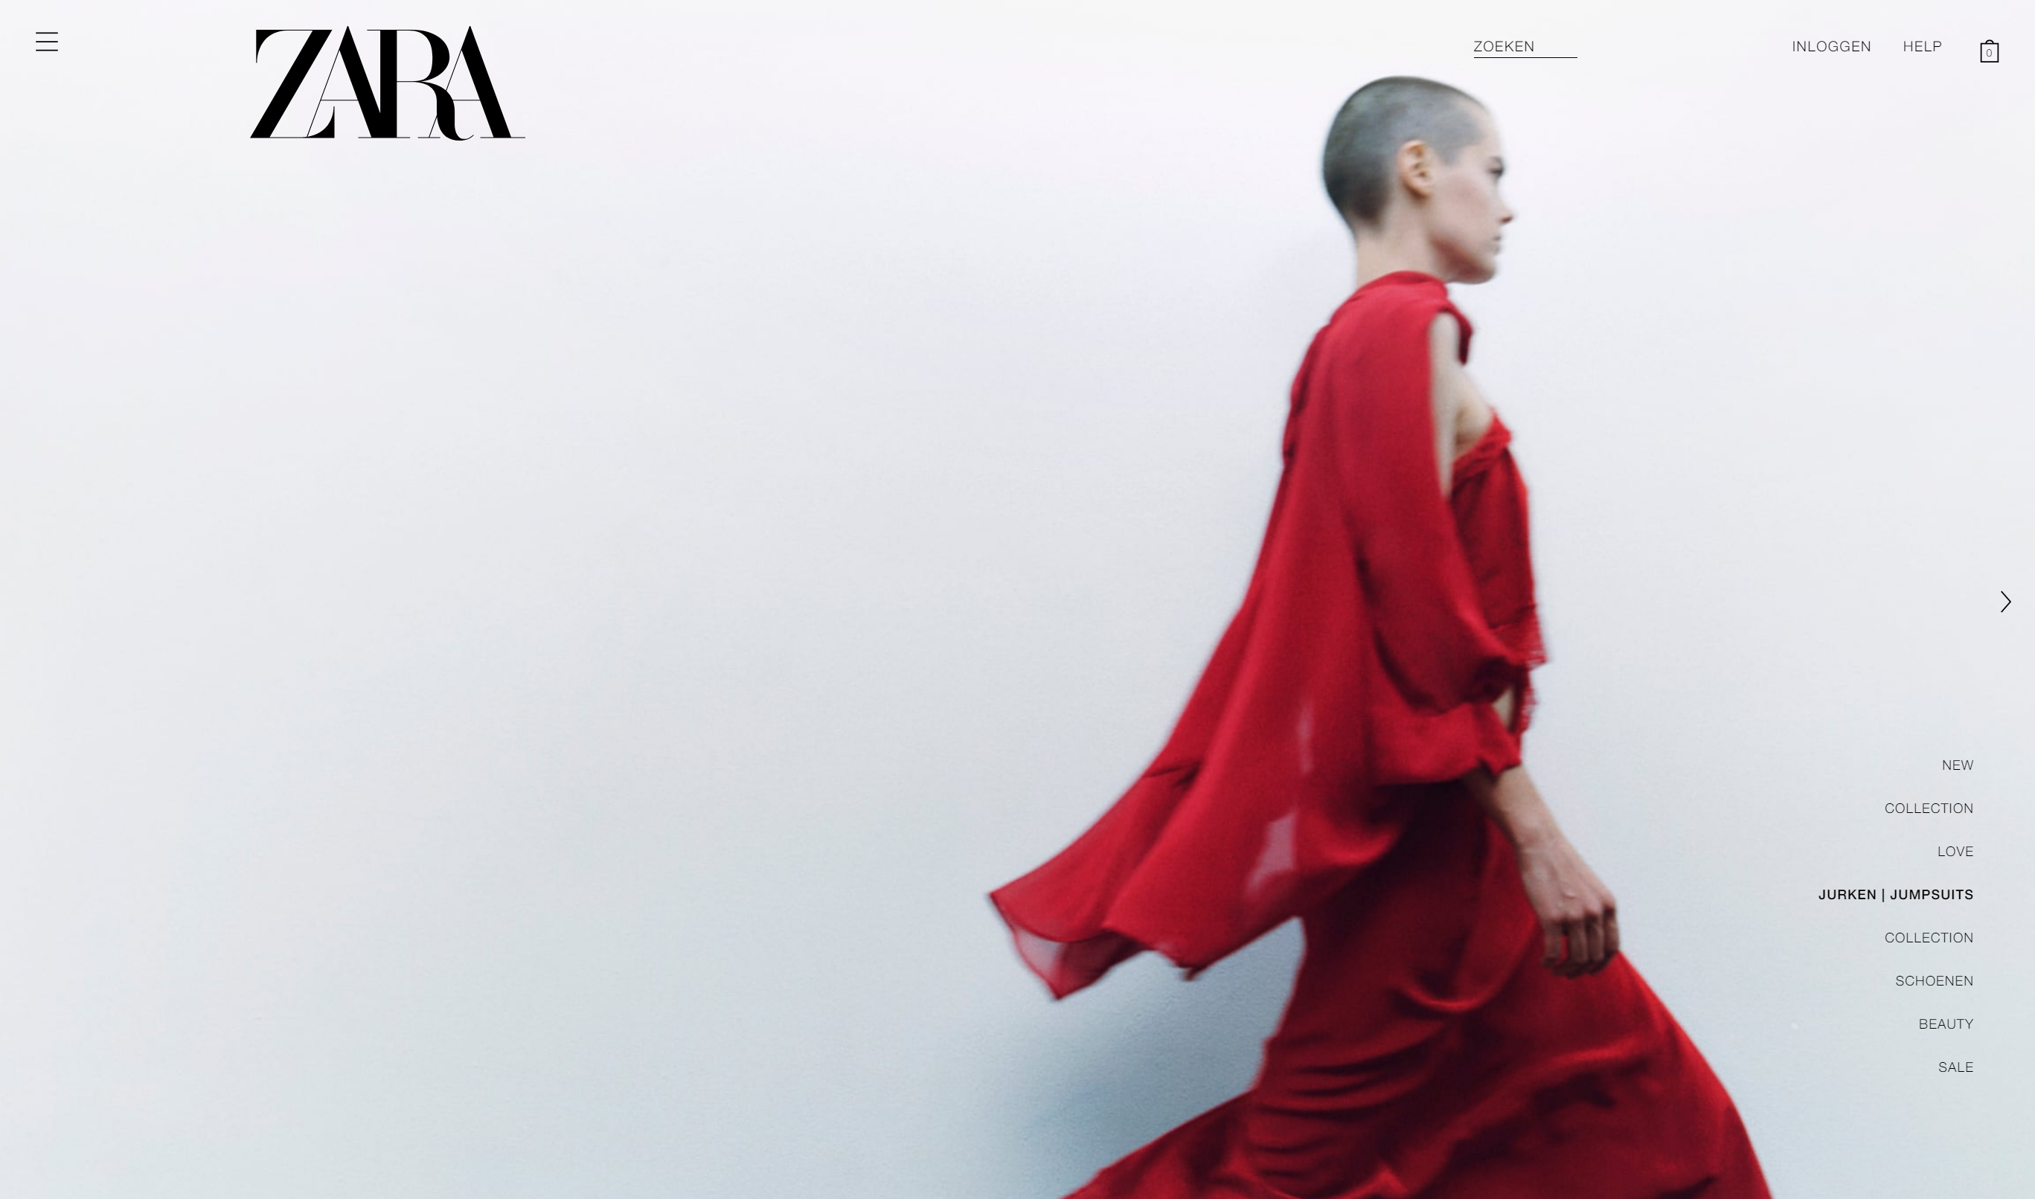
Bad UCD - Zara
All navigation is very small which makes it less visible
There’s no icons besides the category button on the left.
The full screen is a slideshow or video that takes your attention the whole time which is very distracting.

Slide 8
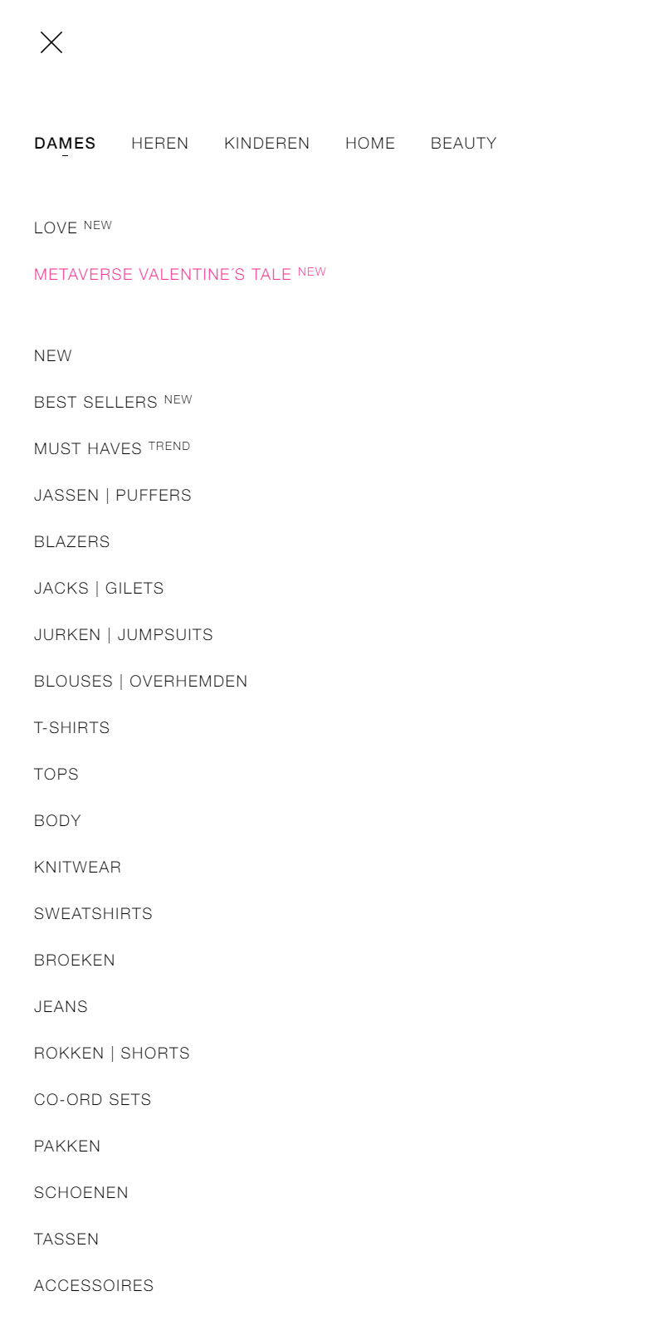
Zara
Also, the categories on the website are endless and hard to navigate through to find what you want.

